Slide 1
ANALYTICS REPORT
GlowCo
E-Commerce Analytics
Sales Performance, Customer Intelligence & Market Insights | 2023 — 2024
Prepared by Joan Nzuma
May 2025

Slide 2
01
Problem Statement
Business context & challenge
TABLE OF
CONTENTS
02
Objectives
Goals of this analysis
03
Sales Overview
Revenue, orders & category performance
04
Customer & Market Intelligence
GlowCo Analytics
2023 — 2024
Segments, channels & global reach
05
Key Findings
Insights & recommendations

Slide 3
01
Problem Statement
“
The Context
GlowCo, a growing beauty and skincare e-commerce brand, operates across multiple sales channels and global markets but lacks a centralized, data-driven system to monitor business performance, understand customer behaviour and identify revenue risks in real time.
The Challenge
Without clear visibility into sales trends, customer segments, product performance and inventory levels, the business struggles to make informed decisions that drive growth, improve retention and prevent revenue loss from stockouts and high return rates.
The Solution
This analysis provides GlowCo's leadership with an interactive analytics dashboard that transforms raw transactional data into actionable insights — enabling smarter decisions across sales, marketing, operations and customer experience.

Slide 4
02
Project Objectives
Monitor and evaluate GlowCo's sales performance across products, categories and time periods.
Analyze sales channel effectiveness and identify the most profitable markets by country and region.
1
4
Segment and understand customer behaviour, retention and purchasing patterns across demographics.
Track inventory levels and flag products at risk of stockout before they impact revenue.
2
5
Assess product performance and identify top selling and underperforming products by revenue and units sold.
Investigate return patterns by category and quantify their financial impact on the business.
3
6

Slide 5
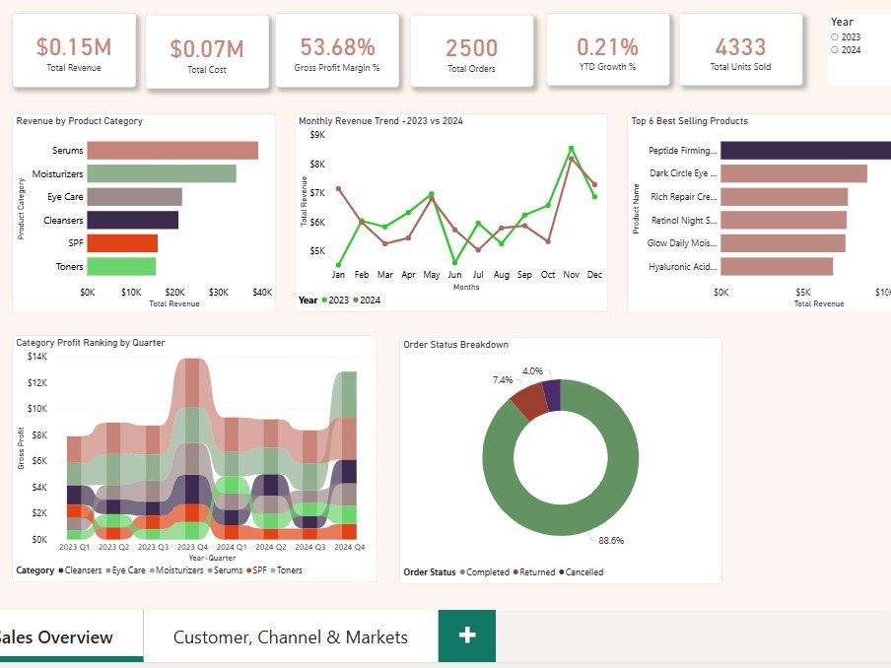
03
Sales Overview
Revenue performance, product categories & order trends | 2023 — 2024
$0.15M
$0.07M
53.68%
2,500
4,333
Total Revenue
Total Cost
Gross Profit Margin
Total Orders
Total Units Sold

Slide 6
03
Sales Insights
📈
Revenue Trend
🌿
Top Category
Revenue peaked in November and December across both 2023 and 2024, confirming strong seasonal demand driven by Black Friday and Christmas shopping periods.
Serums consistently ranked as the highest revenue generating category, followed by Moisturizers — reflecting strong consumer preference for active skincare ingredients.
⭐
Best Selling Product
✅
Order Completion
Peptide Firming Serum led all products in total revenue, indicating strong demand for anti-aging and firming formulations across all customer segments.
88.6% of all orders were completed successfully, with only 7.4% returned and 4% cancelled — reflecting strong product-market fit and customer satisfaction.

Slide 7
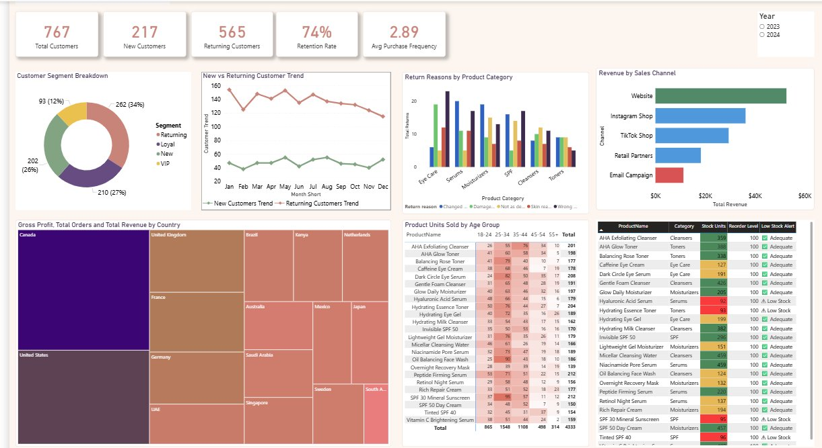
04
Customer & Market Intelligence
Customer segments, purchasing behaviour, channel performance & global reach | 2023 — 2024
767
217
565
74%
2.89
Total Customers
New Customers
Returning Customers
Retention Rate
Avg Purchase Frequency

Slide 8
04
Customer & Market Insights
👥
Customer Retention
🌍
Global Market Reach
74% retention rate indicates strong brand loyalty. Returning, Loyal and VIP segments combined account for the majority of customers, suggesting effective post-purchase engagement.
GlowCo generates revenue across 16 countries spanning 5 regions. The United States, Canada and United Kingdom are the highest gross profit contributing markets.
📱
Top Sales Channel
📦
Return & Inventory Risk
The Website remains the dominant revenue channel, followed by Instagram Shop and TikTok Shop — highlighting the growing importance of social commerce for beauty brands.
Skin Reaction and Wrong Product are the leading return reasons. Several products including Retinol Night Serum and SPF lines have fallen below reorder levels, risking stockouts.

Slide 9
05
Key Findings & Recommendations
KEY FINDINGS
RECOMMENDATIONS
1
Serums and Moisturizers drive the majority of GlowCo's revenue across all markets.
→
Increase inventory for Serums and Moisturizers ahead of Q4 to prevent stockouts during peak season.
2
November and December consistently generate the highest monthly revenue — a clear seasonal spike.
→
Launch targeted Black Friday and Christmas campaigns earlier in October to capture pre-season demand.
3
74% customer retention rate signals strong brand loyalty among existing customers.
→
Invest in VIP and Loyal segment loyalty programs to further increase retention and lifetime value.
4
Website is the top revenue channel; TikTok Shop is rapidly growing in contribution.
→
Allocate more marketing budget to TikTok Shop given its growing revenue contribution trend.
5
Several SKUs have fallen below reorder level, posing a stockout risk in high-demand categories.
→
Review product descriptions and formulations for categories with high Skin Reaction return rates.

Slide 10
Thank You
Turning data into growth, one insight at a time.
Joan Nzuma
Data Analyst | Excel · Power BI · SQL
Power BI
DAX
Excel
SQL
Data Modeling
GlowCo E-Commerce Analytics | 2023 — 2024

